Slide 1
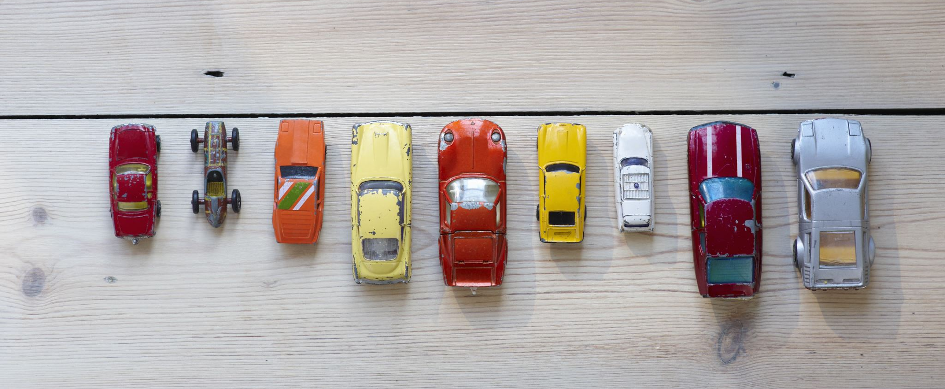
Old car price prediction
Prepared By
Harshilkumar Patel

Slide 2
Background/Motivation
The price of a used car has skyrocketed in the last two years due to the scarcity of microchips in a global market that resulted in a shortage of new cars and a long waiting time for their delivery. Consumers who want to buy cars in a short period of span are left with no option but to look for an old used car. Also, there are customers who cannot afford new cars. This further leads to the question of what the fair price of an old used car would be.

Slide 3

Problem Statement
Price of a used car depends on many factors such as the car's make, model, year, mileage, condition etc. Understanding the value of a used car becomes important for both buyers and sellers. For buyers, it will help them to know if they are paying a fair price for the car, they are interested in. For sellers, it will help them to price their car competitively

Slide 4

Flow of the Project to solve the problem
Collect
Collect data
Prepare
Prepare the data
Choose
Choose a model
Train
Train the model
Evaluate
Evaluate the
Fine-tune
6. Fine-tune the model
Make
Make predictions

Slide 5
Target Audience
Car buyers
Car buyers could use an old car price prediction model to determine the fair market value of a used car, and to identify potential deals or overpriced vehicles.
Private sellers
Private sellers could use old car price prediction model to determine the optimal selling price for their vehicles, based on factors such as age, mileage, and condition.
Insurance companies
Insurance companies could use an old car price prediction model to inform their pricing strategies and to estimate the value of a vehicle in the event of a claim.

Slide 6
Metrics of the Project
Define specific metrics for evaluating the success of the project:
Prediction accuracy: This metric measures how accurately the machine learning model predicts the selling price of old cars based on their features. A high prediction accuracy indicates that the model is effective in providing useful price estimates.
Model performance: This metric measures the performance of the machine learning model, such as its processing speed, scalability, and stability. A high-performance model is efficient, reliable, and capable of handling large volumes of data.
User engagement: This metric measures how engaged and satisfied the target audience is with the old car price prediction campaign. For example, it could be measured by the number of website visits, social media likes and shares, or user feedback and reviews.

Slide 7
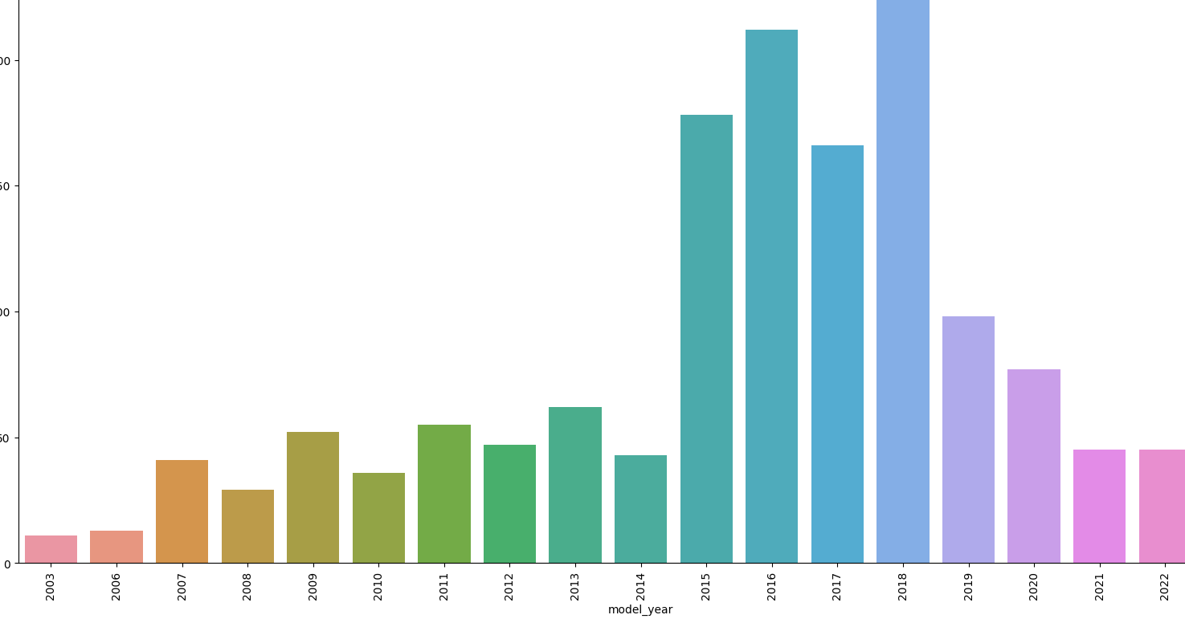
Model Year of The car
We can conclude from the given bar chart that most of the cars which are listed on KIJIJI are from year 2015 to 2018.

Slide 8
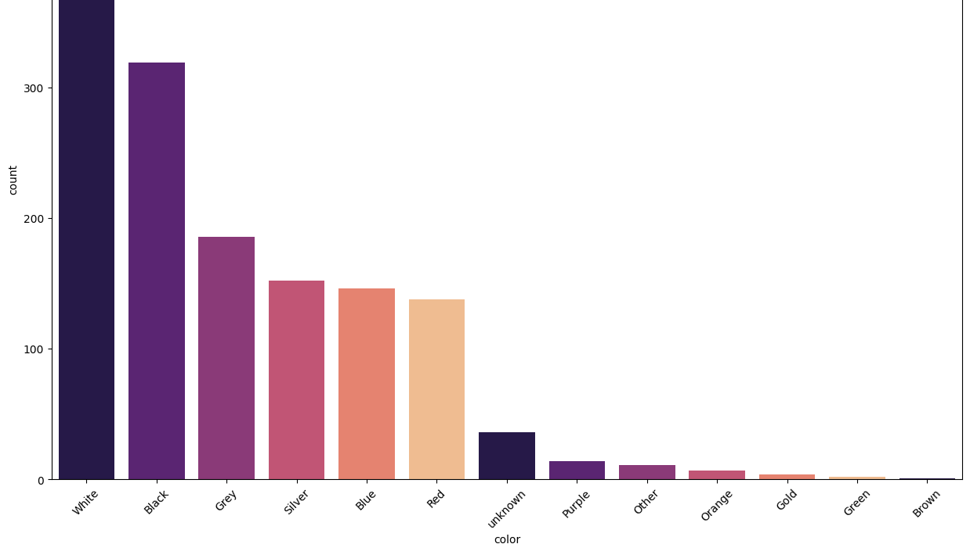
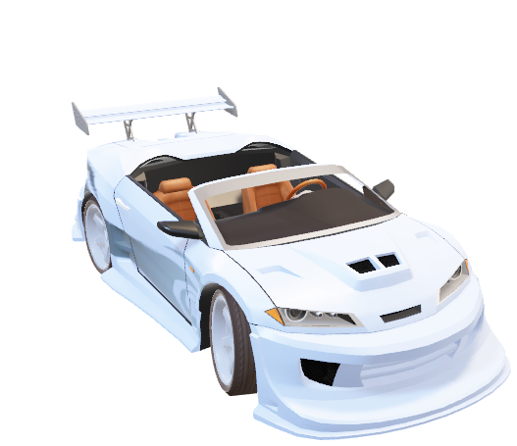
Color of the Car
From the graph, we can observe that the white colored car is the most popular one.
Black and grey colored cars are also purchased more compared to other colored cars.

Slide 9
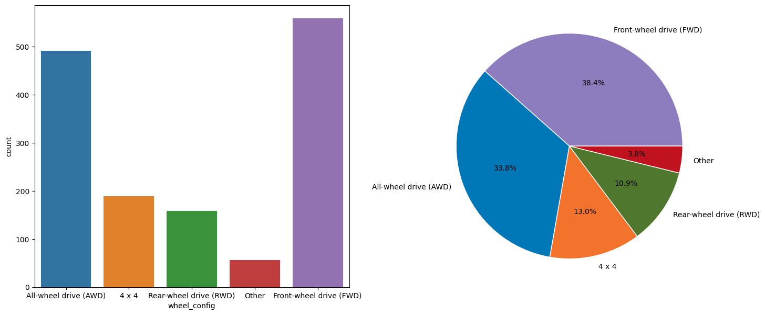
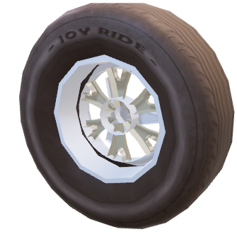
Wheel Config of the car
We can conclude from the given charts that the cars which are listed on the KIJIJI are mostly wither Front-wheel drive or all-wheel drive cars.

Slide 10
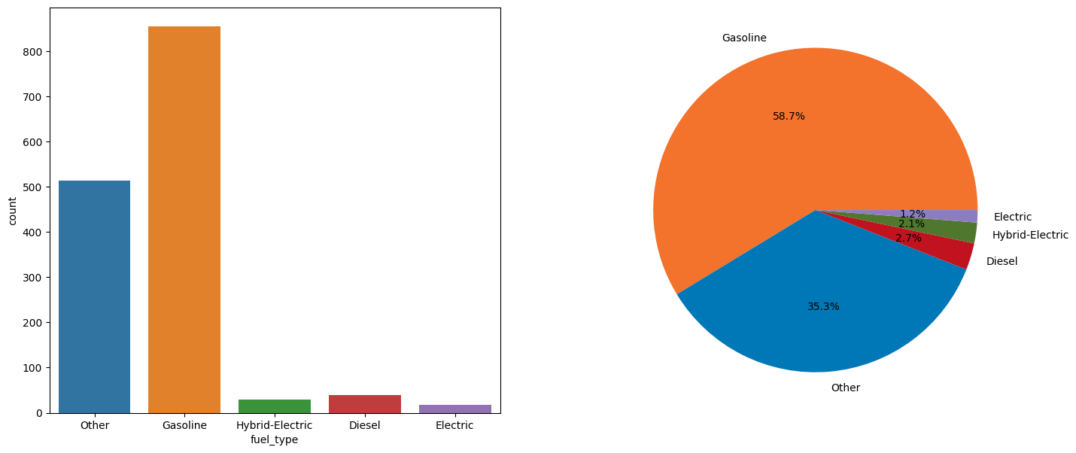
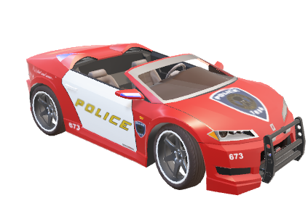
Fuel Type of the Car
We can observe from the given chart that most of the cars listed on KIJIJI uses Gasoline as a fuel compared to other fuels.

Slide 11
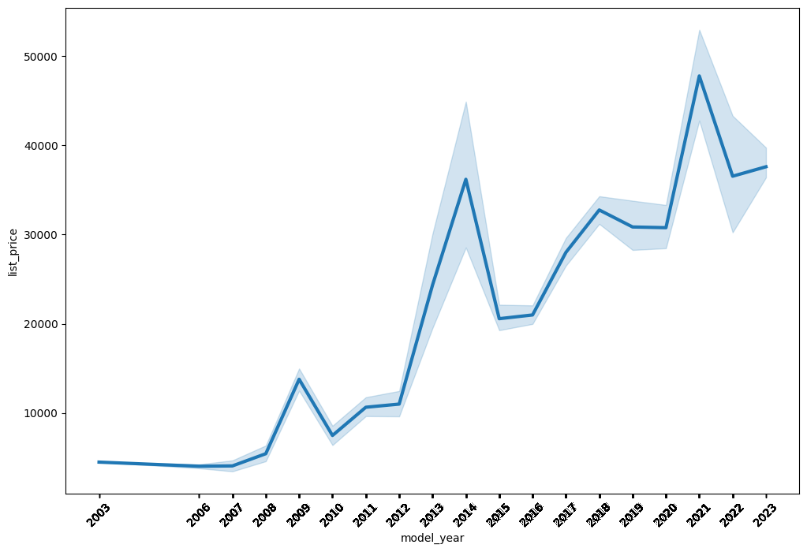

Price vs Model_Year
We can conclude from the graph that there is a positive relationship between the price of the car and the year of the car, as the price of the car increases every year.

Slide 12
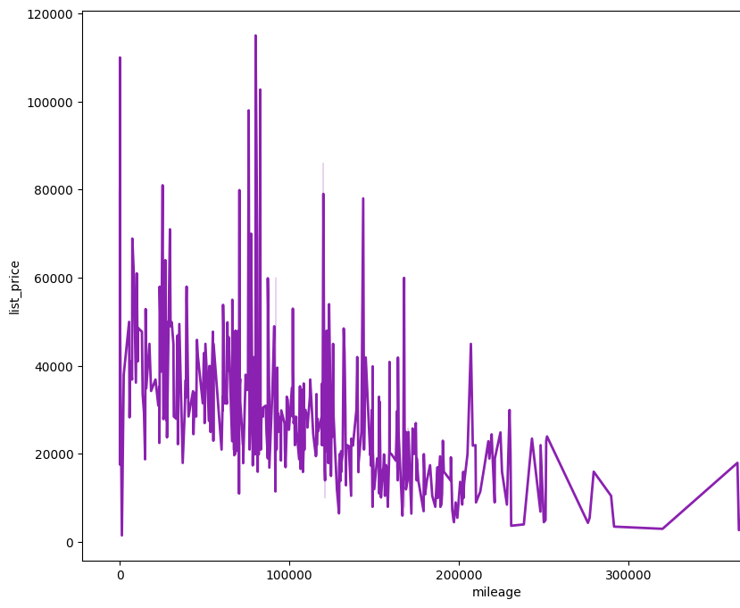

Mileage VS Price
The price of a car tends to fall as the mileage of the vehicle increases since there is a negative relationship between the two. This is due to the fact that increased mileage denotes increased driving, which can result in increased wear and tear on the engine, gearbox, and other components.

Slide 13
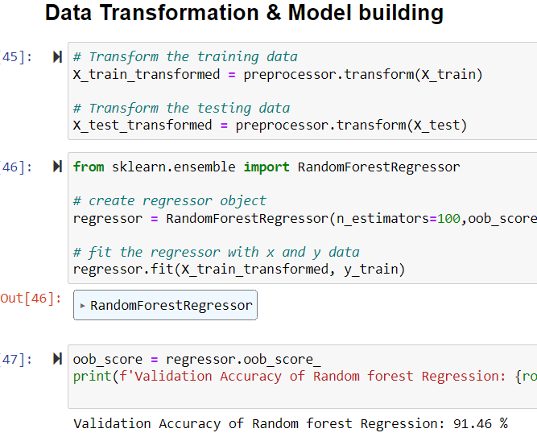
Result
After cleaning and transforming the data, I have applied Random forest regression Model.
I have obtained 91.46% accuracy on validation data.

Slide 14


